Slide 1
CS-683 Project Presentation Check Point 1 Update for Course Project
Pasham Pranay, S Naresh godspeed_cache
23m1123@iitb.ac.in, 23m1200@iitb.ac.in

Slide 2
Problem statement
Dead page in TLB or dead block in cache:
1. Entries with no hits before eviction
Predicting and bypassing dead entries:
1. Reduces capacity misses
2. Efficient TLB and Cache usage
Aim: Explore and enhance dead page and dead block predictors for STLB and LLC
Baseline: “Dead Page and Dead Block Predictors: Cleaning TLBs and Caches Together” HPCA,2021
1. Dead-on-arrival page predictor (STLB)
2. Page-correlated dead block predictor (LLC)
Idea: Dynamic dead block predictor
1. Selects between cbPred and standalone dead block predictor
2. Possibility to improve performance across diverse workloads

Slide 3
Prior Works
Paper-1(Baseline): C. Mazumdar, P. Mitra and A. Basu, "Dead Page and Dead Block Predictors: Cleaning TLBs and Caches Together," 2021 IEEE International Symposium on High-Performance Computer Architecture (HPCA), Seoul, Korea (South), 2021, pp. 507-519, doi: 10.1109/HPCA51647.2021.00050
Paper-2: Carole-Jean Wu, Aamer Jaleel, Will Hasenplaugh, Margaret Martonosi, Simon C. Steely, and Joel Emer. 2011. SHiP: signature-based hit predictor for high performance caching. In Proceedings of the 44th Annual IEEE/ACM International Symposium on Microarchitecture (MICRO-44). Association for Computing Machinery, New York, NY, USA, 430–441. https://doi.org/10.1145/2155620.2155671
Paper-3: Abhishek Bhattacharjee. 2017. Translation-Triggered Prefetching. In Proceedings of the Twenty-Second International Conference on Architectural Support for Programming Languages and Operating Systems (ASPLOS '17). Association for Computing Machinery, New York, NY, USA, 63–76. https://doi.org/10.1145/3037697.3037705

Slide 4
Goal of the Project
Literature survey of dead block and dead page predictors, focusing on Paper-1 as our baseline.
Evaluating the baseline and outline our approach for implementing the proposed improvement to the baseline.
Implement and evaluate our proposed improvement and compare it against the baseline.

Slide 5
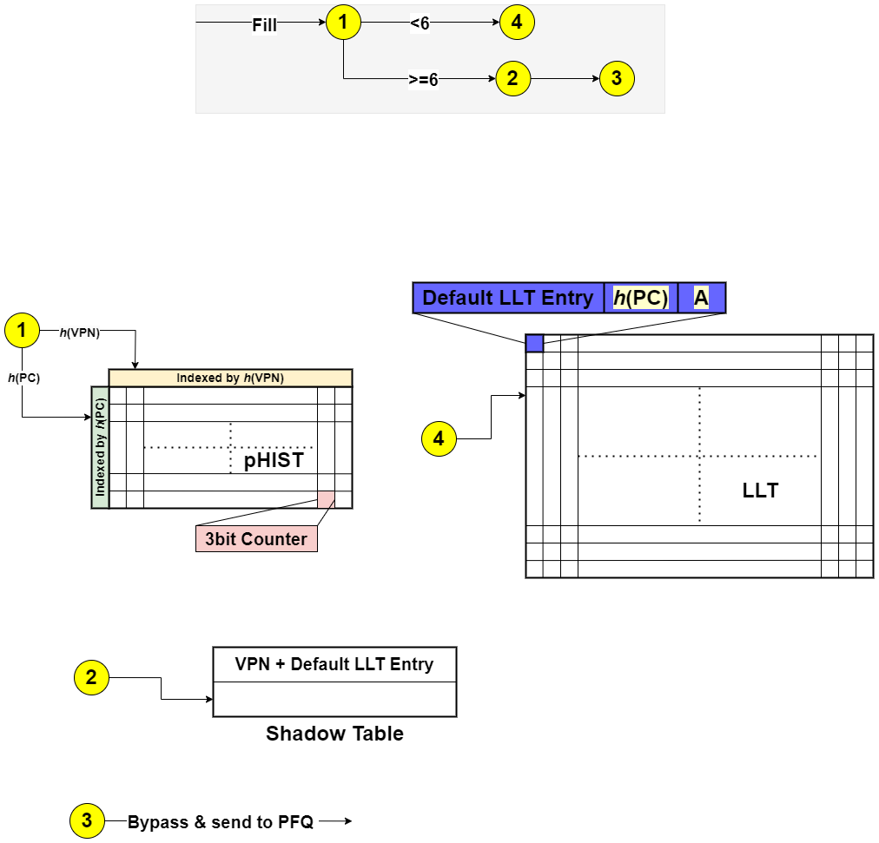
Work done so far : Literature Survey on Baseline dead page Predictor(dpPred): Fill

Slide 6
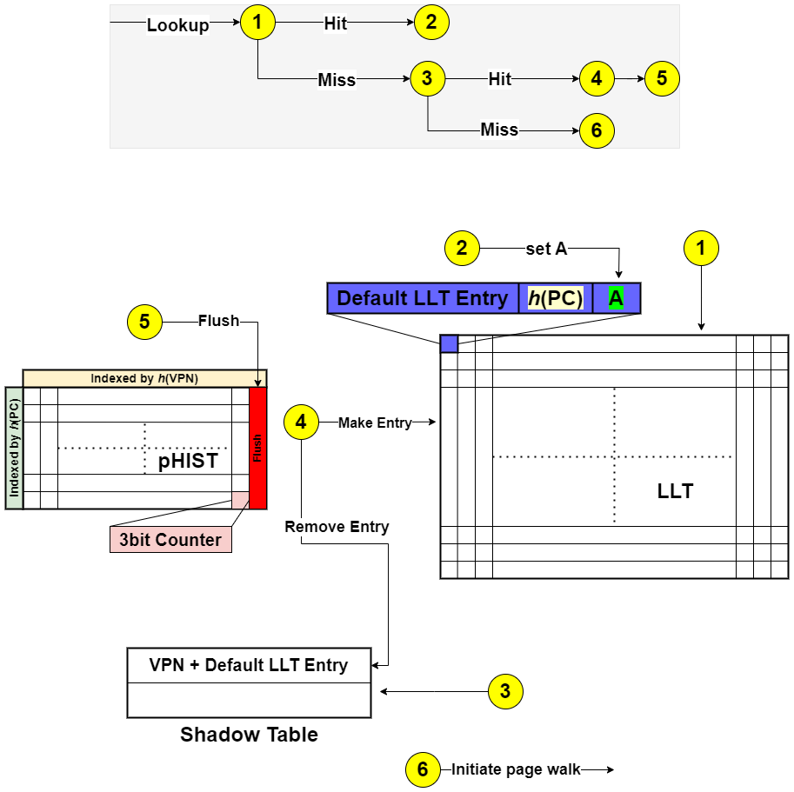
Work done so far : Literature Survey on Baseline dead page Predictor(dpPred): Lookup

Slide 7
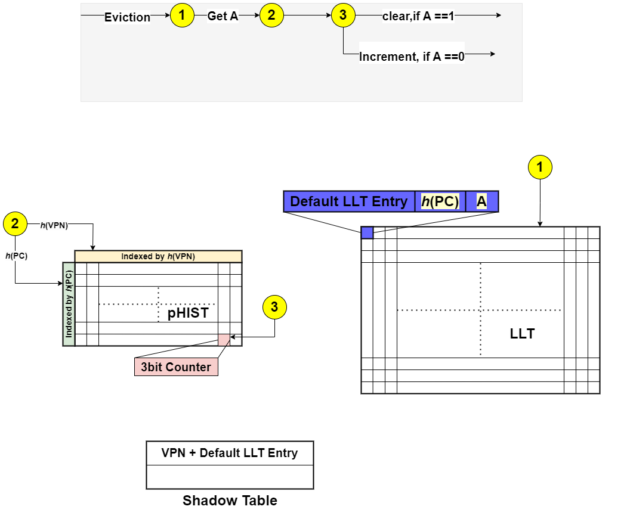
Work done so far : Literature Survey on Baseline dead page Predictor(dpPred): Eviction

Slide 8
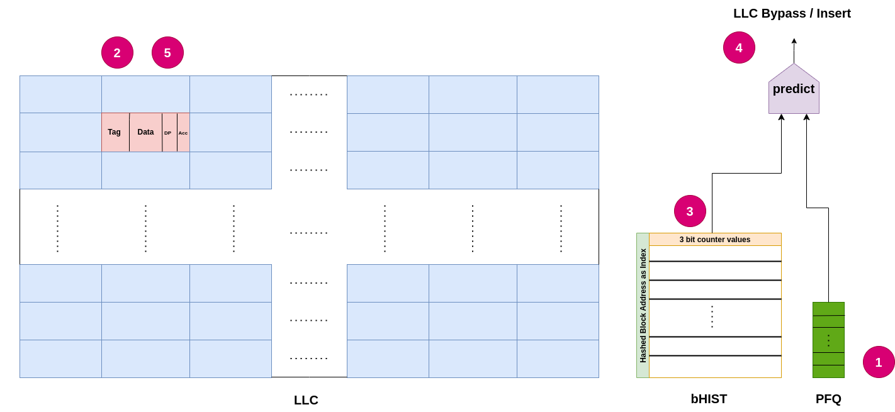
Work done so far : Literature Survey on Baseline correlating dead block Predictor(cbPred):Fill

Slide 9
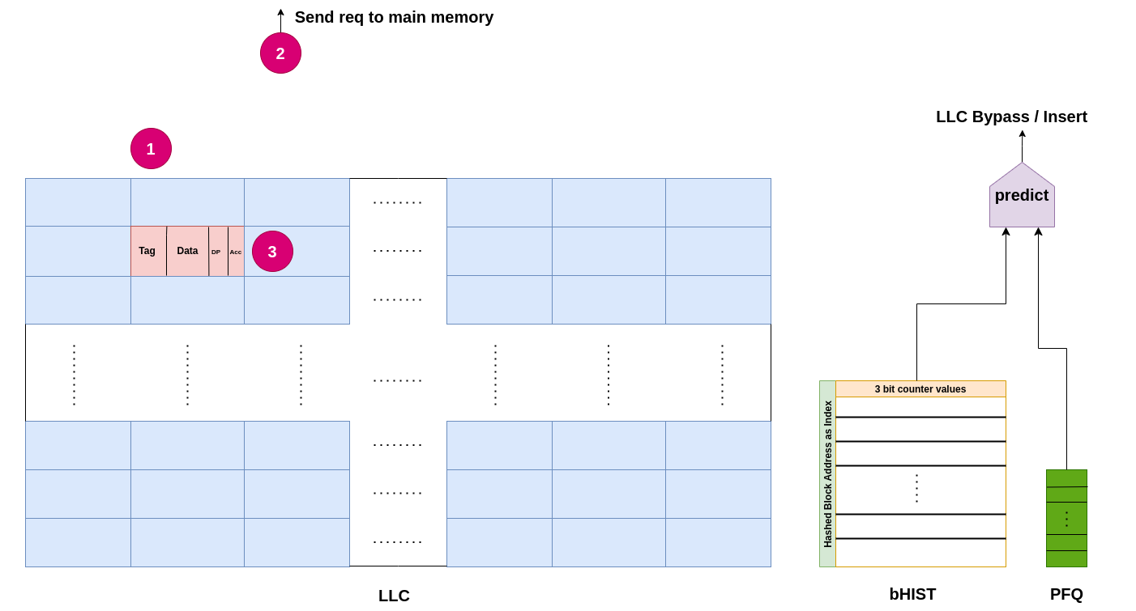
Work done so far : Literature Survey on Baseline correlating dead block Predictor(cbPred):Lookup

Slide 10
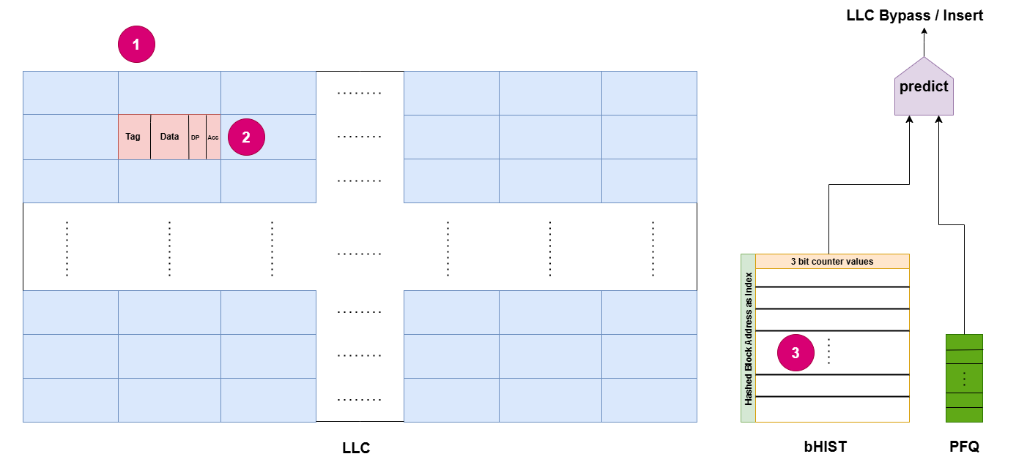
Work done so far : Literature Survey on Baseline correlating dead block Predictor(cbPred):Eviction

Slide 11
Results (Legible fonts in plots please)
No results yet

Slide 12
Plan for checkpoint-II
Checkpoint-2: We will evaluate the baseline and outline our approach for implementing the proposed improvements/additions to the baseline.
Division of Labor: Will divide the baseline evaluation equally based on the benchmarks and propose improvement/additions as group

Slide 13
Github link
https://github.com/sankenaresh/CS683_Project_godspeed_Cache.git

Slide 14
Thank You

